Slide 1
Delete in an AVL tree
tNode *delete(tNode *node, int D) {
if(node == NULL) { return NULL; }
if(D < node->data)
node->left = delete(node->left, D);
else if(D > node->data)
node->right = delete(node->right, D);
else {
if(node->left != NULL)
node->left = extractMax(node->left, node);
else if(node->right != NULL)
node->right = extractMin(node->right, node);
else { free(node); return NULL; }
}
node->height = 1 + MAX(h(node->left), h(node->right));
return balance(node);
}

Slide 2
Space overhead per node
Our AVL tree nodes store the (absolute) height of each node in the tree
typedef struct node {
int data;
struct node *left;
struct node *right;
int height; // sizeof(int) overhead per node
} tNode;
This can be reduced to two bits overhead per node:
LeftHeavy, Balanced, RightHeavy
Slightly more complex insert/delete/balance
another example of the space/time tradeoff!

Slide 3
AVL trees with n nodes have O(log n) height
Recall: AVL Trees ensure that height difference between left and right sub-trees is at most 1
Let m(h) be the minimum number of nodes in an AVL tree of height h
If an AVL tree with n nodes has height h then n ≥ m(h)
Hence, h ≤ m⁻¹(n) [assuming m is an increasing function]
Now m(0) = 1, m(1) = 2, m(2) = 4, m(3) =
∀h ≥ 2, m(h) = 1 + m(h − 1) + m(h − 2)
F(0) = F(1) = 1; ∀h ≥ 2, F(h) = F(h − 1) + F(h − 2)
Prove that ∀h ≥ 0, m(h) = F(h+2) − 1
1 +
m(2) +
m(1)
= 7

Slide 4
Critique this “proof”
Given: m(0) = 1, m(1) = 2; ∀h ≥ 2, m(h) = 1 + m(h − 1) + m(h − 2)
and F(0) = F(1) = 1; ∀h ≥ 2, F(h) = F(h − 1) + F(h − 2)
We will prove that ∀h ≥ 0, m(h) = F(h+2) − 1 by induction on h
Base case (h = 0): m(0) = 1 and F(2) = F(0) + F(1) = 1 + 1 = 2
so the base case holds ☺
Inductive step (h > 0): m(h) = 1 + m(h − 1) + m(h − 2)
= 1 + F(h+1) − 1 + F(h) − 1 by the inductive hypothesis
= F(h+2) − 1 by the definition of F
☺
Fails for h = 1

Slide 5
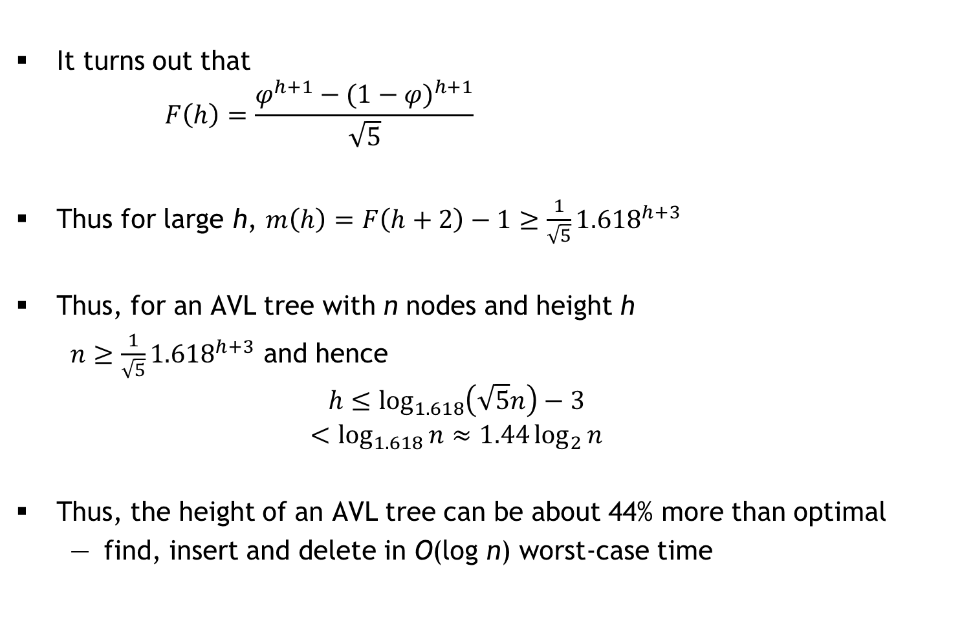
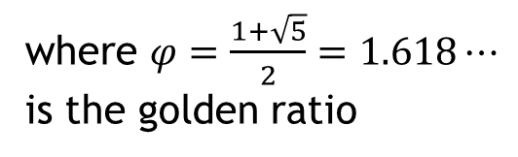
Fibonacci numbers and the Golden Ratio
It turns out that
$$F\left(h\right)=\frac{φ^{h+1}−{(1−φ)}^{h+1}}{\sqrt{5}}$$
Thus for large h, $m\left(h\right)=F\left(h+2\right)−1≥\frac{1}{\sqrt{5}}{1.618}^{h+3}$
Thus, for an AVL tree with n nodes and height h
$n≥$ $\frac{1}{\sqrt{5}}{1.618}^{h+3}$ and hence
$$h≤\log_{1.618}\left(\sqrt{5}n\right)−3$$
$$<\log_{1.618}{n}≈1.44\log_{2}{n}$$
Thus, the height of an AVL tree can be about 44% more than optimal
find, insert and delete in O(log n) worst-case time
where $φ=\frac{1+\sqrt{5}}{2}=1.618⋯$
is the golden ratio

Slide 6
Dictionary ADT
A dictionary stores (key, value) pairs where keys are totally ordered
e.g., integers, reals, vectors, strings, …
For a key k, a dictionary has at most one pair (k, v)
#ifndef DICT_H
#define DICT_H
typedef void* DictEntry;
void setValue(DictEntry, value_t);
value_t getValue(DictEntry);
typedef void* Dict;
void freeDict(Dict);
int isEmpty(Dict);
int size(Dict);
Dict insert(Dict, key_t, value_t);
DictEntry get(Dict, key_t);
Dict delete(Dict, key_t);
DictEntry forall(Dict, int(*task)(int, void*), void*);
#endif
int cmp(key_t, key_t)
Assuming cmp runs
in O(1) time!
Linked list | AVL tree
O(1) | O(1)
O(n) | O(n)
O(n) | O(log n)
Replace old value if
key already exists

Slide 7
Research Note
A comparison of dictionary implementations by Mark Neyer, 2009
This paper explores several implementations of dictionaries:
hash tables, Red-Black Trees, AVL Trees, and Skip Lists
The Microsoft .NET platform was chosen for this experiment because it is of interest to the author’s experience in industry, and due to the availability of a precise memory measurement debugging library, namely sos.dll
Implementations
System.Collections.hashtable
AVL tree implementation: www.vcskicks.com
Red-Black tree implementation: www.devx.com/DevX/Article/36196
Skip List implementation: www.codeproject.com/KB/recipes/ skiplist1.aspx
No mention of hardware!

Slide 8
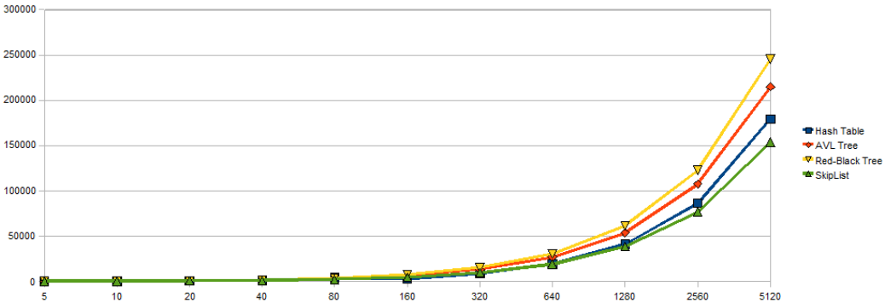
Results (1/3)
Size (in bytes) vs. n

Slide 9
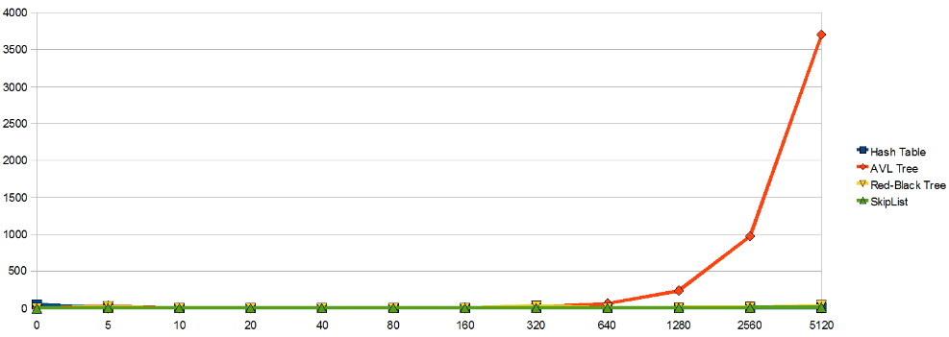
Results (2/3)
Creation time (in milliseconds) vs. n

Slide 10
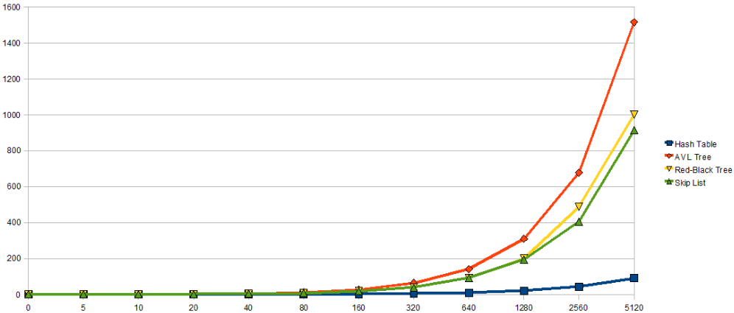
Results (3/3)
Query time for 100n keys (in milliseconds) vs. n

